Slide 1

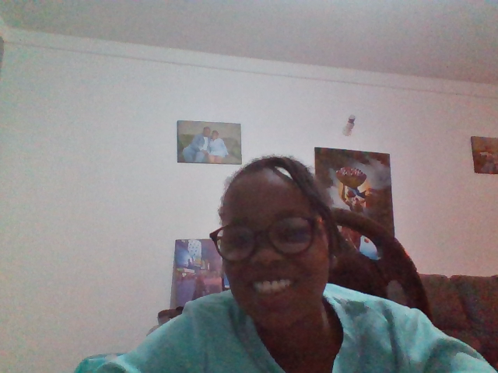
MY FAMILY
BY CHRISTINA WANGUI

Slide 2
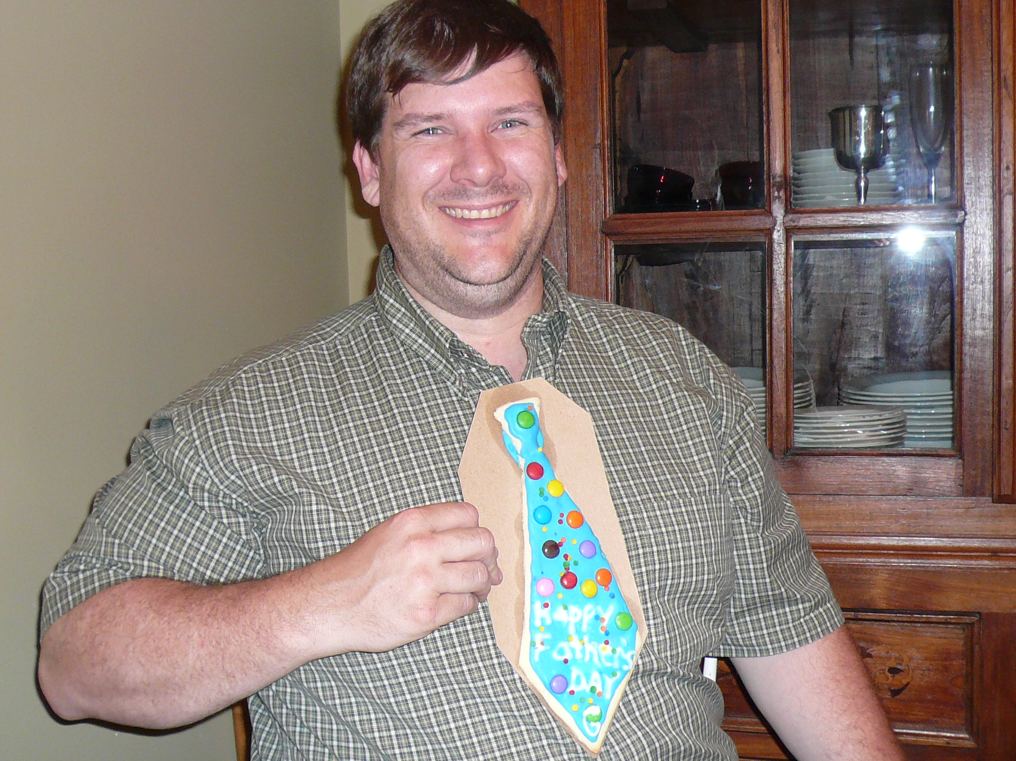
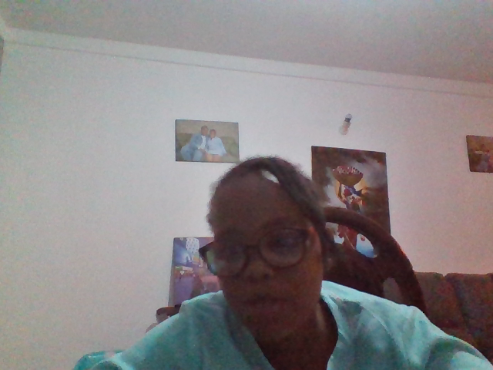
MY FATHER
My father is called James matthenge Gakuu
He is a handsome man
He is thirty three years old
His favourite colour is blue
He is as tall as a giraffe
I love my father so much
This Photo by Unknown Author is licensed under CC BY-SA

Slide 3
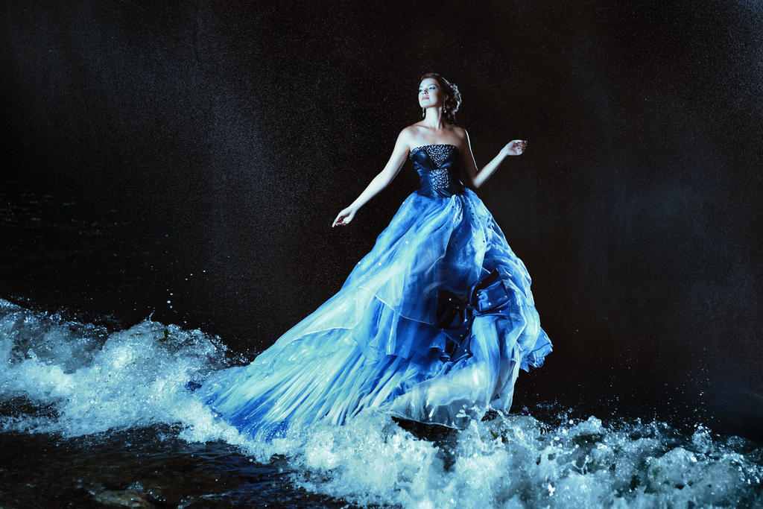
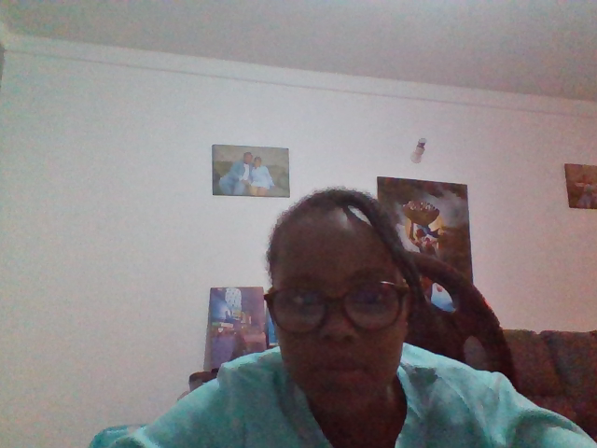
MY MOTHER
My mother is called Martha Wambui Kamau
She is a beautiful lady
She is thirty two years old
She is as short as a harmmer
Her favourite colour is black
I love my mother
This Photo by Unknown Author is licensed under CC BY

Slide 4
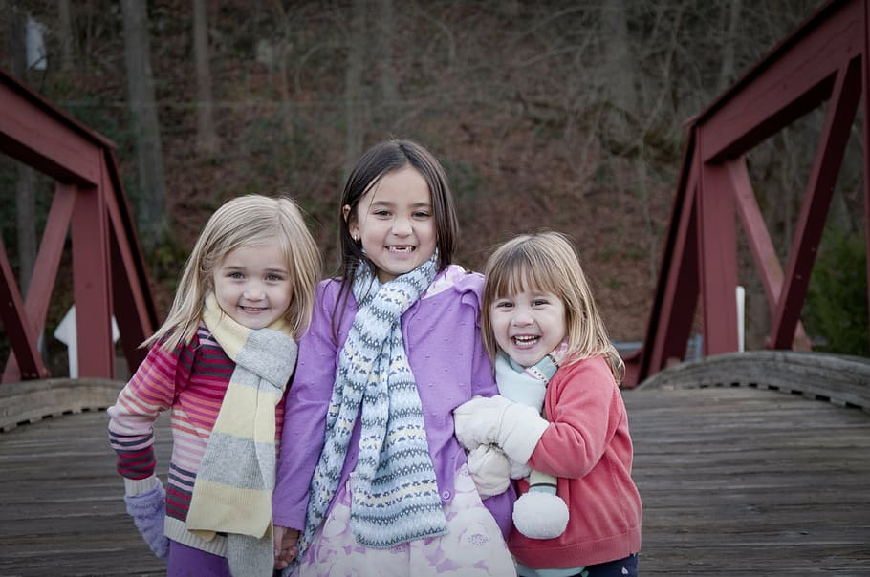
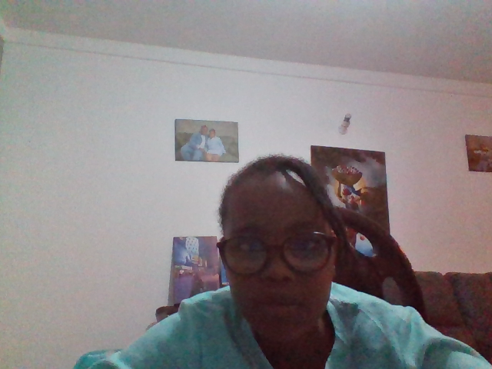
MYSELF
My name is called Christina wangui.I am the first born sister
I am ten years old
I am as tall as a giraffe
I am a beautiful and neat girl
I study in Chantilly School
I love myself very much

Slide 5
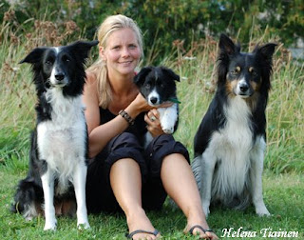
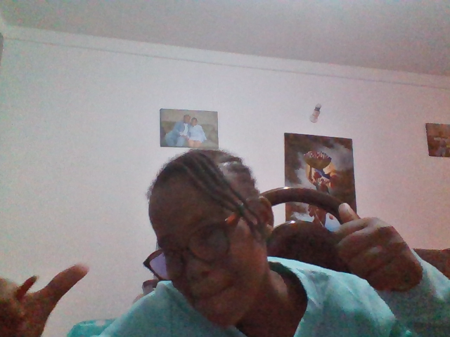
MY SECOND BORN SISTER
My second born sister is called Clara Nyambura Gakuu
She is a girl
She is nine years old
She lives in Homex
Her favourite colour is purple
I love my sister very much
This Photo by Unknown Author is licensed under CC BY-NC-ND

Slide 6
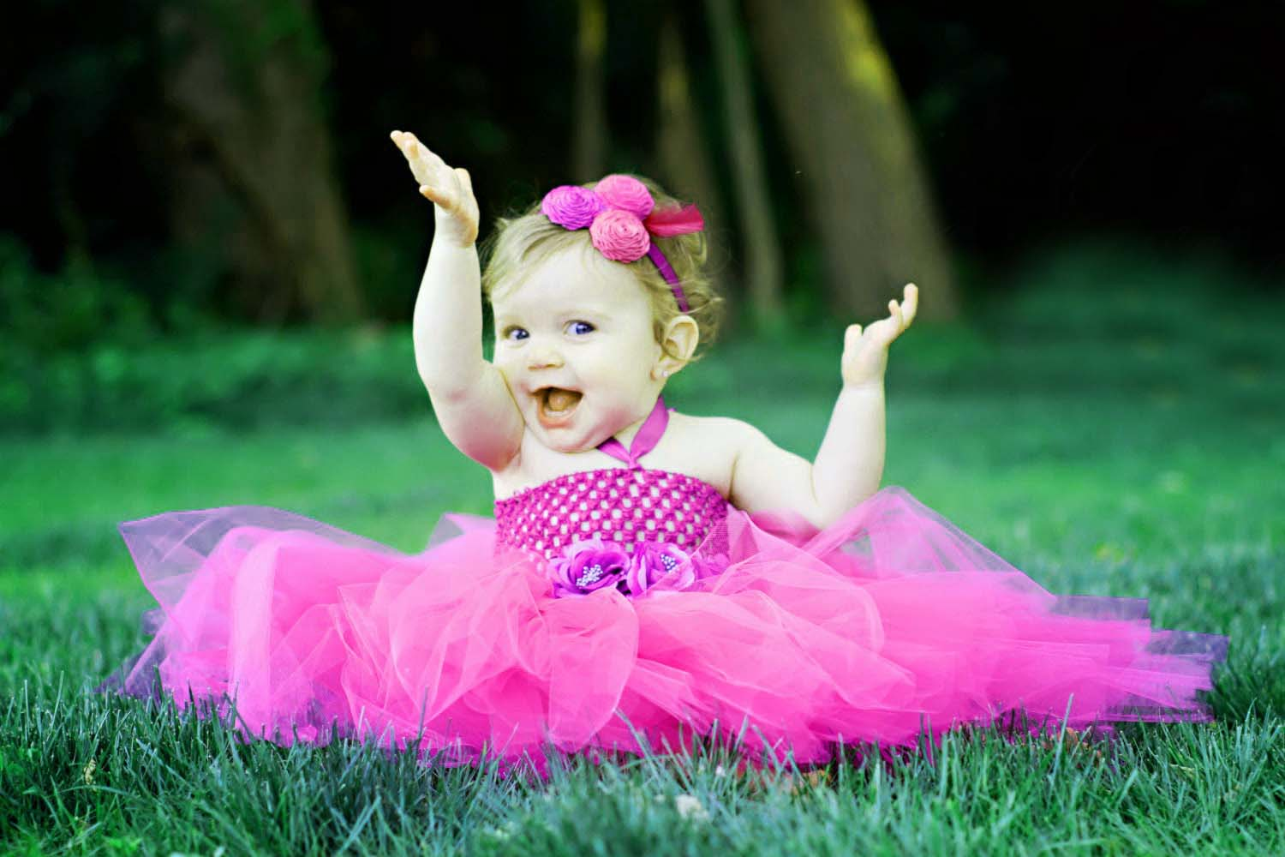
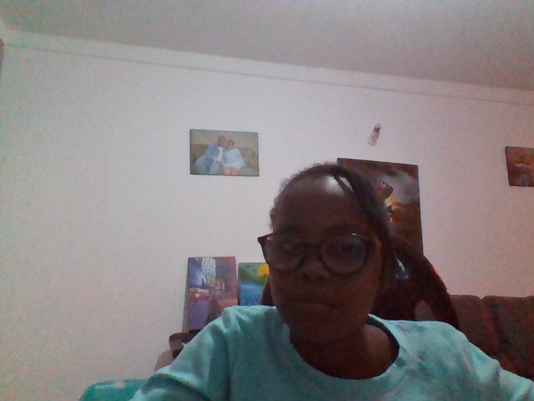
MY THIRD BORN SISTER
My third born sister is called Christabel Wango Gakuu
She is a girl
She is one year old
Her favourite colour is red
She is as short as a harmmer
I will never forget my sister until I kick the bucket
This Photo by Unknown Author is licensed under CC BY-NC-ND

Slide 7
